Slide 1
LLM Agents - From Language Models to Autonomous Intelligence
Gnanambhal Shivarraman

Slide 2
Section I: Why LLMs Alone Aren’t Enough
LLMs are stateless – no memory of past actions or goals
No tool use – can’t fetch real-time data, search, or calculate
No goal pursuit – can’t plan or act over time
Output is text-only, no execution or interactivity
Passive: react to prompts, don’t do things
They are smart, but not truly autonomous!

Slide 3
Section 1I: What is an LLM Agent?
“A system that uses a large language model to reason, plan, and act in an environment using tools, memory, and feedback.”
Core Components
LLM (Reasoning Engine) – interprets and generates actions
Tools – APIs, calculators, search engines, code interpreters
Memory – stores past interactions and context
Planner / Loop – decides next actions based on goals
Environment – where the agent acts (web, shell, game, etc.)
From Language Model → Cognitive Agent : LLM Agents = LLM + Agency

Slide 4
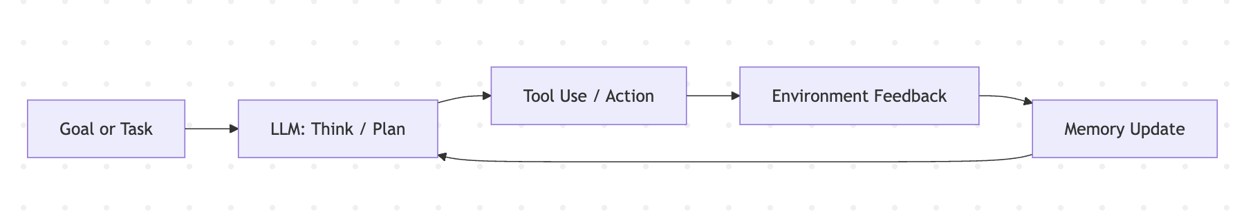
Section III: Anatomy of an LLM Agent
This loop continues until the goal is achieved or the agent stops.
Key Modules
Planner (LLM Prompting) – decides what to do next
Action Executor – runs code, APIs, or tools
Memory System – stores facts, history, observations
State Tracker – tracks what’s been done so far
Output Formatter – final result summarizer or presenter
Example Agent Architectures
ReAct – reasoning + acting in steps
AutoGPT – goal-driven autonomy with memory
LangChain Agents – modular tool-executing frameworks

Slide 5
Section IV: Spotlight Paper 1 - Agent Laboratory: Using LLM Agents as Research Assistants
Problem Statement Scientific research is often constrained by time, cost, and human bandwidth, limiting the number of ideas explored.
Proposed Solution Agent Laboratory – an LLM agent framework that assists researchers by automating the literature review, experimentation, and paper writing stages, while allowing human feedback.
Methodology (The 3-stage Pipeline)
Literature Review – PhD agent curates papers using arXiv API.
Experimentation – ML & SW Engineer agents implement plans using the mle-solver, a self-reflective code generation tool.
Report Writing – Professor agent uses paper-solver to generate and refine LaTeX-formatted reports.

Slide 6
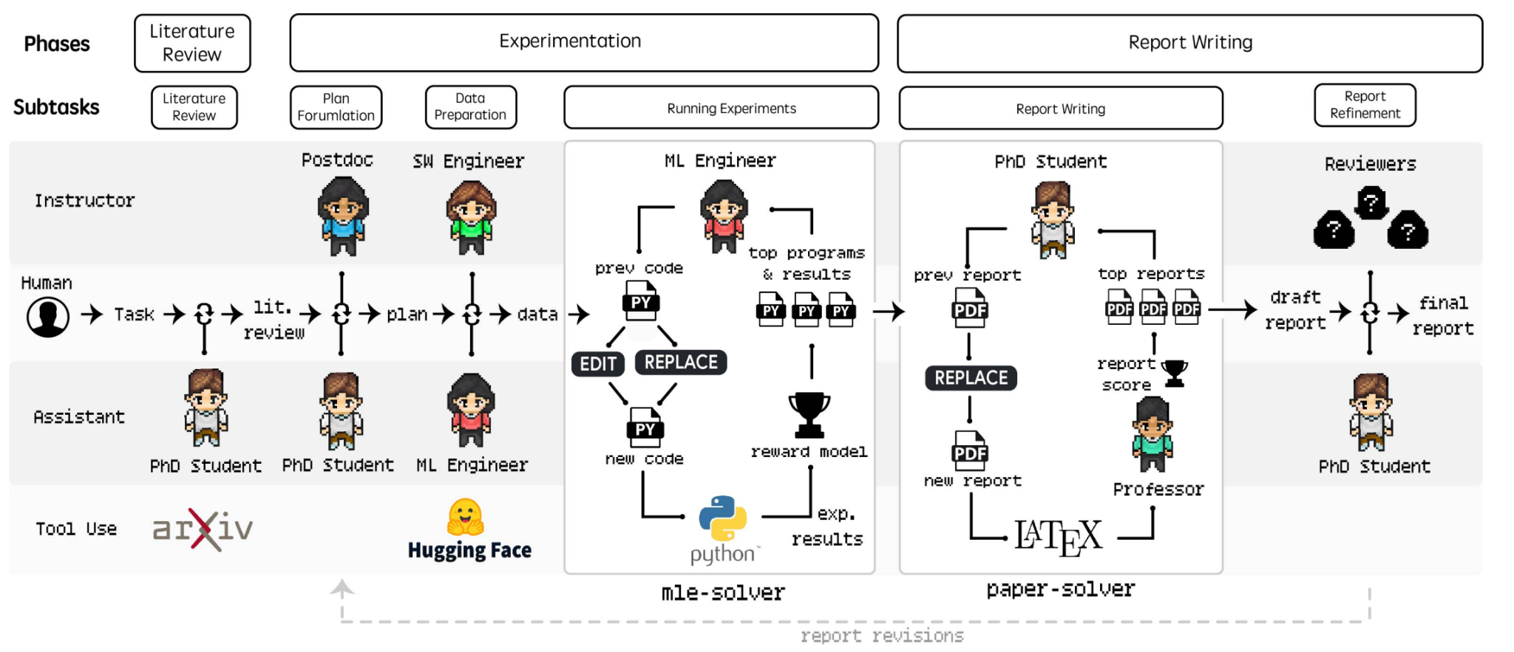
Section IV: Spotlight Paper 1 - Agent Laboratory: Using LLM Agents as Research Assistants
Key Features:
Co-pilot mode for human involvement.
Uses different LLM backends (o1-preview, o1-mini, GPT-4o).
Cost-efficient ($2.33 per paper with GPT-4o).

Slide 7
Section IV: Spotlight Paper 1 - Agent Laboratory: Using LLM Agents as Research Assistants
Results
o1-preview showed highest usefulness (4.4/5); o1-mini led in experimental quality (3.2/5).
Co-pilot mode consistently outperformed autonomous mode.
Cost-effective: $2.33/paper with GPT-4o.
Outperformed other solvers on MLE-Bench in code generation consistency and performance.

Slide 8
Section IV: Spotlight Paper II - Plan-Then-Execute: An Empirical Study of User Trust and Team Performance When Using LLM Agents As A Daily Assistant
Problem Statement LLM agents are increasingly used for daily tasks, but how user involvement in planning and execution affects trust and team performance remains unclear.
Proposed Solution Introduce a plan-then-execute framework for LLM agents, and empirically study how user involvement in both planning and execution stages impacts:
Trust calibration
Task accuracy and effectiveness

Slide 9
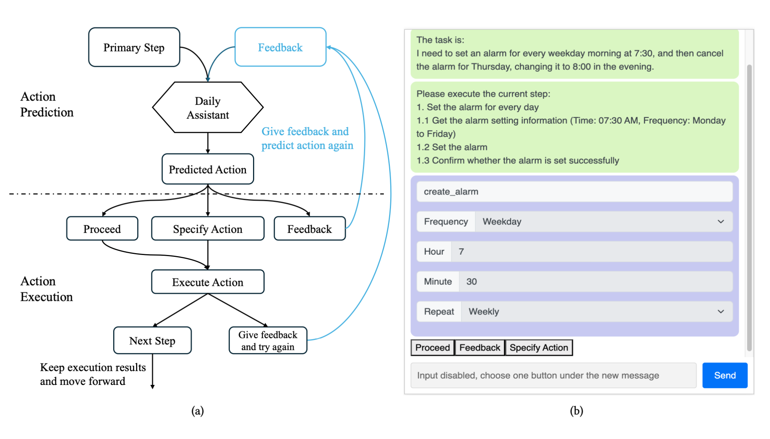
Section IV: Spotlight Paper II - Plan-Then-Execute: An Empirical Study of User Trust and Team Performance When Using LLM Agents As A Daily Assistant
Methodology
Conducted a user study (N = 248) across 6 daily task scenarios (e.g., flight booking, currency transactions).
2×2 factorial design: Planning: automatic vs. user-involved Execution: automatic vs. user-involved
Tasks executed in a simulation environment via LangChain-based agent.
Measured: plan quality, execution accuracy, trust ratings, cognitive load.

Slide 10
Section IV: Spotlight Paper II - Plan-Then-Execute: An Empirical Study of User Trust and Team Performance When Using LLM Agents As A Daily Assistant
Results
User-involved planning improved task outcomes and plan quality.
User-involved execution enhanced error detection and task performance.
However, trust calibration didn’t always improve — users sometimes trusted plausible-looking but incorrect plans.
High user involvement also increased cognitive load.

Slide 11
Section IV: Spotlight Paper III - AutoAgent — A Fully-Automated and Zero-Code Framework for LLM Agents
Problem Statement Most existing LLM agent frameworks (LangChain, AutoGen, etc.) require coding expertise, limiting accessibility for non-technical users.
Proposed Solution AutoAgent - an agent operating system enabling users to create and customize agents, tools, and workflows through natural language alone, with:
No programming required
Automated orchestration and execution
Compatibility with multiple LLMs and APIs

Slide 12
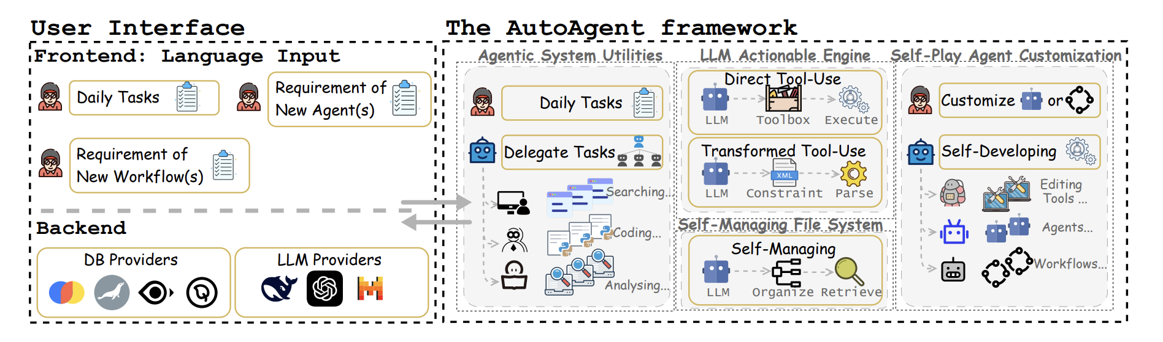
Section IV: Spotlight Paper III - AutoAgent — A Fully-Automated and Zero-Code Framework for LLM Agents
System consists of 4 components:
Agentic System Utilities: Modular web, file, and coding agents
LLM-powered Actionable Engine: Decision-making brain
Self-Managing File System: Converts multimodal data into structured vector stores
Self-Play Agent Customization: Auto-generates tools, workflows, and agents via XML templates

Slide 13
Section IV: Spotlight Paper III - AutoAgent — A Fully-Automated and Zero-Code Framework for LLM Agents
Results
Ranked #2 overall on GAIA benchmark
Outperformed LangChain and others on MultiHop-RAG (73.5% acc vs 62.8%)
Successfully generated complex agents (e.g., DaVinci art generator, Financial Orchestrator) without human coding
Showed potential in task decomposition, dynamic resource orchestration, and scaling laws via agent workflows

Slide 14
Section IV: Spotlight Paper IV - PaSa: An LLM Agent for Comprehensive Academic Paper Search
Problem Statement Current academic search engines (e.g., Google Scholar) often fail on complex, fine-grained scholarly queries—e.g., finding papers on "non-stationary RL using UCB methods."
Proposed Solution PaSa, a dual-agent system (Crawler + Selector) designed to:
Autonomously search, read, and filter papers
Navigate citation graphs
Answer complex, multi-hop academic queries

Slide 15
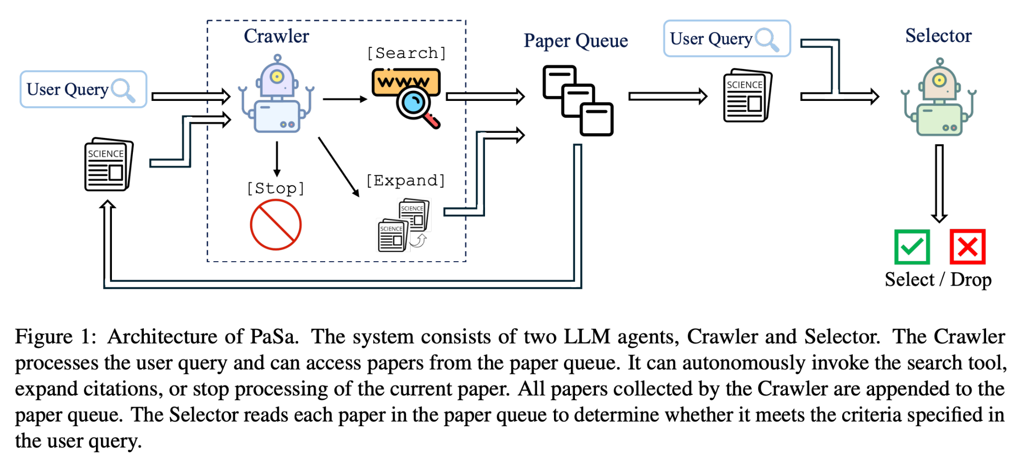
Section IV: Spotlight Paper IV - PaSa: An LLM Agent for Comprehensive Academic Paper Search

Slide 16
Section IV: Spotlight Paper IV - PaSa: An LLM Agent for Comprehensive Academic Paper Search
Methodology
Architecture:
Crawler Agent: Uses search tools + citation crawling to build a dynamic paper queue
Selector Agent: Reads papers and filters relevant ones based on query fit
Trained using reinforcement learning (AGILE framework) + imitation learning
Two datasets:
AutoScholarQuery (synthetic): 35k paper-query pairs from top AI conferences (ICLR, NeurIPS, ACL)
RealScholarQuery (real-world): 50 expert-labeled complex academic queries
Uses session-level PPO for long-horizon RL with sparse rewards

Slide 17
Section IV: Spotlight Paper IV - PaSa: An LLM Agent for Comprehensive Academic Paper Search
Results
On RealScholarQuery:
PaSa-7B outperformed all baselines (including GPT-4o, ChatGPT + Google)
+37.8% Recall@20 vs GPT-4o + Google baseline
+30.3% recall vs prompt-based PaSa-GPT-4o
- Selector module significantly improved recall in long-tail retrieval
- Performs better than human-in-the-loop GPT+search setups

Slide 18
Section IV: Spotlight Paper V - CLADD: Retrieval-Augmented LLM Agents for Drug Discovery
Problem Statement LLMs have potential in drug discovery, but domain-specific fine-tuning is expensive and inflexible. Can we dynamically use external biomedical knowledge for zero-shot tasks in drug discovery?
Proposed Solution CLADD (Collaborative LLM Agents for Drug Discovery): A multi-agent, RAG-powered system that:
Retrieves and contextualizes biomedical data
Uses specialized agents for planning, molecular understanding, and knowledge graph traversal
Operates without domain-specific fine-tuning

Slide 19
Section IV: Spotlight Paper V - CLADD: Retrieval-Augmented LLM Agents for Drug Discovery
Modular agent teams: 1. Planning Team: Determines relevant data sources (KGs, tools)
2. Knowledge Graph Team: Retrieves relations from domain-specific biomedical graphs
3. Molecule Understanding Team: Leverages molecule annotations and external tools (e.g., MolT5)
4. Prediction Agent: Synthesizes all reports into a final answer
Agents communicate via structured messages (e.g., XML) and use anchoring (structural similarity) for unknown molecules
Handles diverse tasks: 1. Molecular captioning 2. Drug-target prediction 3. Molecular toxicity classification

Slide 20
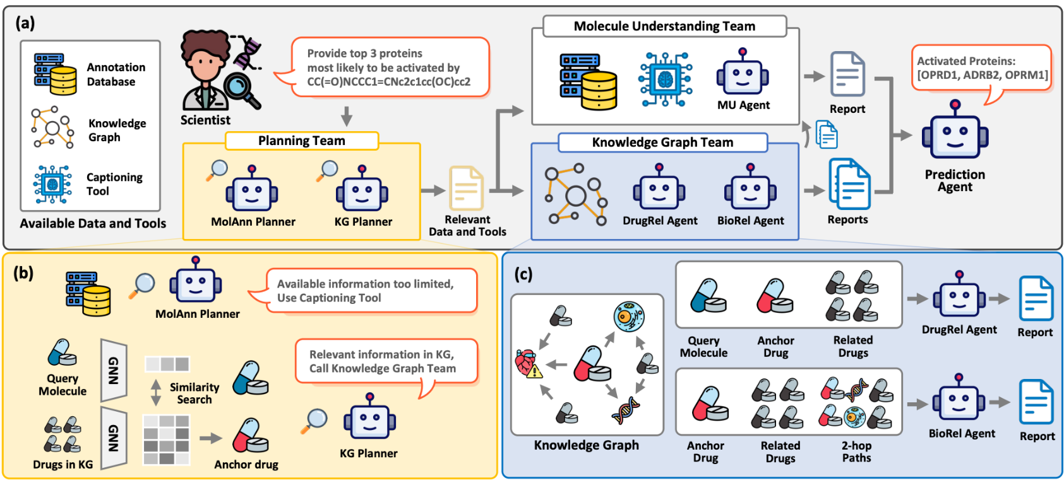
Section IV: Spotlight Paper V - CLADD: Retrieval-Augmented LLM Agents for Drug Discovery

Slide 21
Section IV: Spotlight Paper V - CLADD: Retrieval-Augmented LLM Agents for Drug Discovery
Results
Outperforms domain-specific LMs and fine-tuned GNNs on multiple tasks:
Captioning: +5–10% AUROC across BBBP, SIDER, ClinTox, BACE datasets
Target prediction (P@5): Up to 4.8× improvement over GPT-4o and Galactica
Toxicity prediction: Strong performance with explainability
Flexible: Can work with new tasks/tools without retraining
Transparent: Agent reports help with interpretability and human trust

Slide 22
Section IV: Spotlight Paper VI - Large Language Models as Urban Residents: An
LLM Agent Framework for Personal Mobility
Generation
Problem Statement Urban mobility models often require structured data and struggle to adapt to unseen situations. → Can LLMs simulate human-like activity trajectories with semantic reasoning and interpretability?
Proposed Solution LLMob — a self-consistent, retrieval-augmented LLM agent framework that:
Learns habitual activity patterns and motivations from real mobility data
Generates daily activity plans in natural language + coordinates
Operates without hand-crafted rules or domain-specific tuning

Slide 23
Section IV: Spotlight Paper VI - Large Language Models as Urban Residents: An
LLM Agent Framework for Personal Mobility
Generation
Methodology
Two-phase architecture:
Phase 1 – Pattern Identification: Uses past trajectory data + personas to extract self-consistent behavioral patterns
Phase 2 – Activity Generation: Generates daily plans using motivation retrieval strategies: A. Evolving-based: recent activities guide next-day plans
B. Learning-based: contrastive similarity of past trajectories
Agents generate JSON-formatted plans + reasoning Evaluated using real mobility data from Tokyo (check-ins, categories, timestamps)

Slide 24
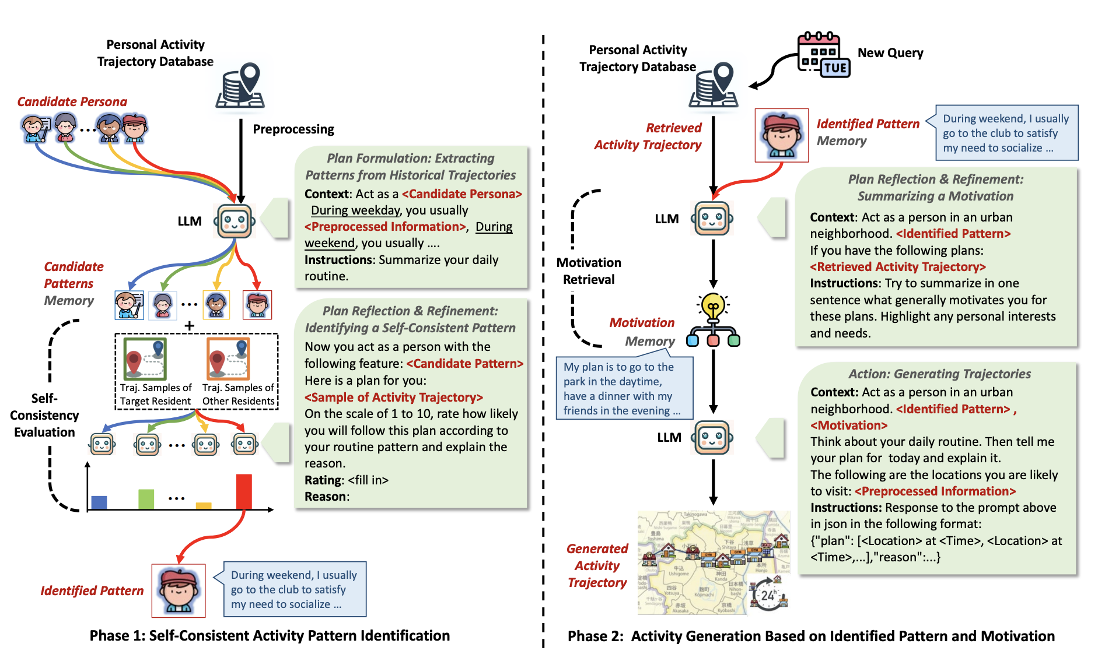
Section IV: Spotlight Paper VI - Large Language Models as Urban Residents: An
LLM Agent Framework for Personal Mobility
Generation

Slide 25
Section IV: Spotlight Paper VI - Large Language Models as Urban Residents: An
LLM Agent Framework for Personal Mobility
Generation
Results
Outperformed baselines (LSTM, attention models, GAIL, diffusion) on: 1.1. Spatial-temporal coverage (STVD) 1.2. Semantic pattern fidelity (DARD) 1.3. Step distance/interval accuracy
Can simulate behavior under specific contexts (e.g., pandemic scenarios)
Generates interpretable, diverse, and realistic activity plans from LLMs

Slide 26
Section V: Challenges and Open Research Questions
Trust Calibration & Control Users may over-trust plausible outputs, or face high cognitive load during agent supervision.
Evaluation Misalignment
Automated metrics overestimate agent performance (Agent Laboratory)
Lack of standardized benchmarks for complex agent tasks (PaSa)
Domain Adaptation Without Fine-Tuning Biomedical reasoning still struggles without structured, validated domain inputs.
Scalability & Composition Complex workflows and multi-agent systems are hard to orchestrate, debug, or scale robustly.
Grounding & Factuality in Open-World Tasks Agents operating in dynamic environments (science, mobility) risk hallucinations or shallow reasoning.

Slide 27
Summary & Conclusions
LLM agents are evolving—from answering questions to taking action.
They’re transforming how we research, build, and collaborate.
But challenges remain: trust, grounding, control, and scale.
The future? Smarter, adaptive, collaborative agents - built to work with us.

